Slide 1
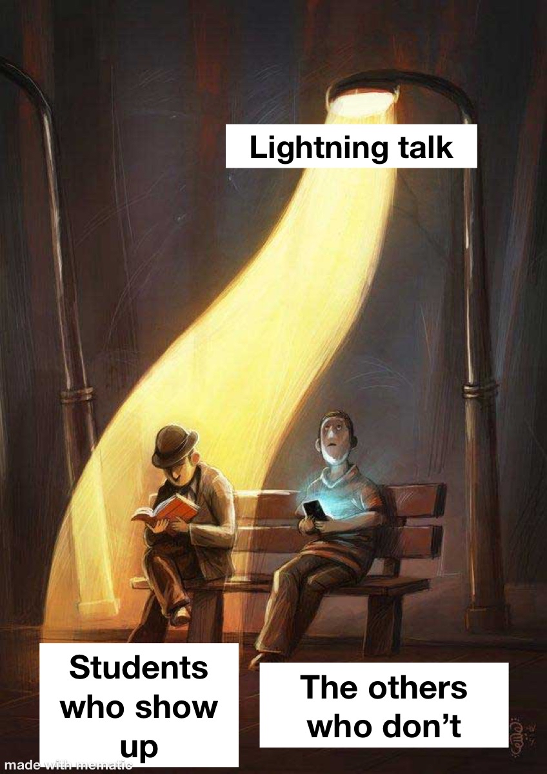
WELCOME TO THE LEUPHANA TUTORIUM!
LANGUAGE IN THE LEUPHANA SEMESTER
Ariane Steiner, Natasha Shituvi, Espen Rechtsteiner
05.11.2025
Notes:
Hannah

Slide 2
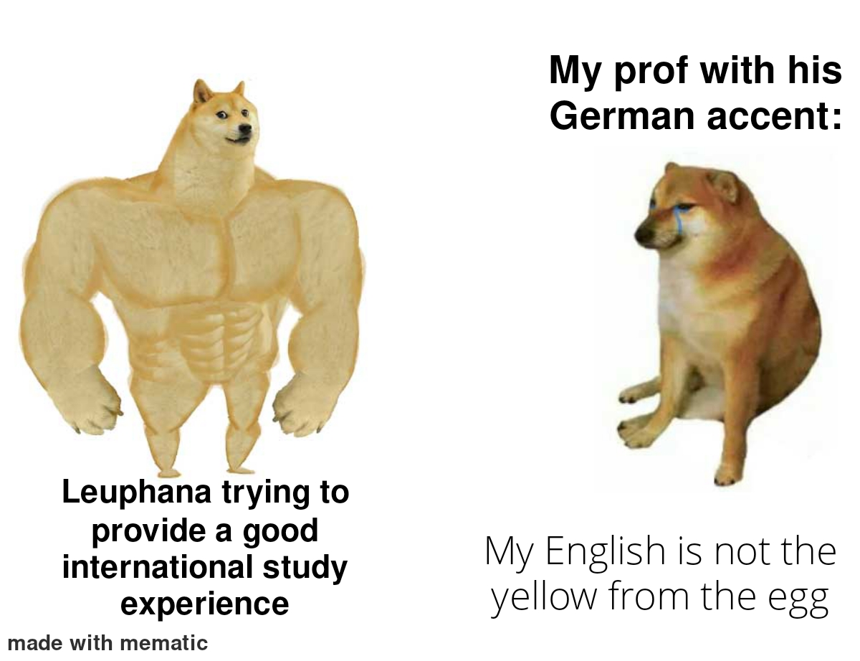

Slide 3
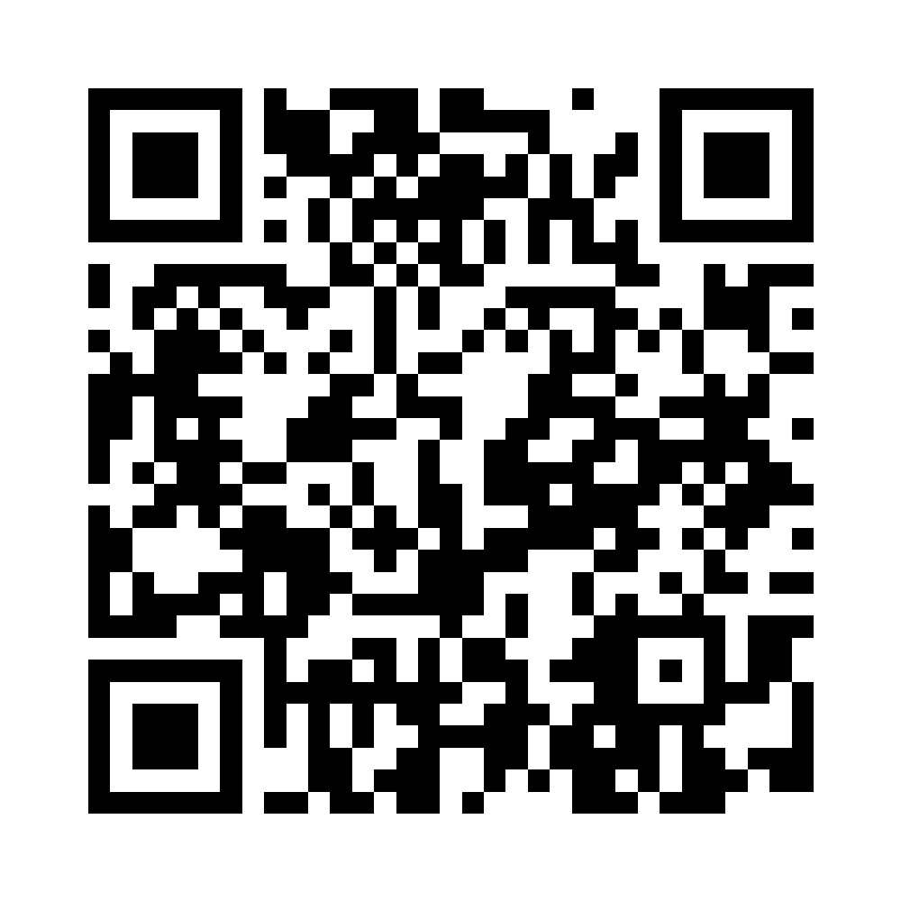
Survey
Do you feel comfortable with studying in English at Leuphana?
Does it make sense to you that parts of the teaching are in English at Leuphana?
Scan the QR or go to
https://particify.rz.tu-bs.de/p/45888794
Notes:
Ari

Slide 4
Internationality at Leuphana
Leuphana has around 10.000 students
More than 10% Internationals
Providing english course offers to include internationals/provide possibility of studying for those who haven't learned German
Equip students with international skills and capability
Enriches the material available for your studies (American research, British data)

Slide 5
English during your Studies
English as scientific language --> most research is published in English
Leuphana Semester as an option to practise English --> doesn't have to be perfect
English as an important language in daily life --> good practice for studying abroad (multiple options)
Create international connections (friends, initiatives)
Notes:
Most papers and research is published in English --> sources for own work will probably also be in English

Slide 6
Personal Experience
Struggled with English in the beginning as well
Got easier over course of studying
Good practice for doing a semester abroad
Natasha: had German as the foreign language and did Abitur
My parents couldn't speak German, lived in an English speaking world
Got through it with supportive friends/peers
Notes:
Most papers and research is published in English --> sources for own work will probably also be in English

Slide 7
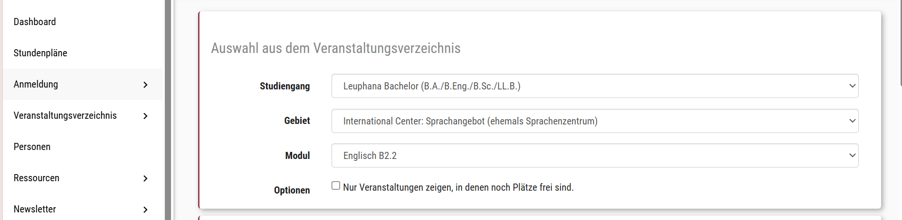
Tips and Tricks
Leuphana Sprachenzetrum offers free language courses
English Language Café - C.5 104, Wednesdays 6 to 7 pm
Einfügen wie auf mystudy finden
Notes:
Most papers and research is published in English --> sources for own work will probably also be in English

Slide 8
Tips and Tricks
Find others with same struggle to help each other
Try to learn specific vocabulary, not translate everything to German
easier to look at slides than understanding everything that is being said
Entspannte Zweisprachigkeit as a way to communicate
Notes:
Most papers and research is published in English --> sources for own work will probably also be in English

Slide 9

Tips and Tricks
Find others with same struggle to help each other
Try to learn specific vocabulary, not translate everything to German
easier to look at slides than understanding everything that is being said
Entspannte Zweisprachigkeit as a way to communicate
Notes:
Most papers and research is published in English --> sources for own work will probably also be in English

Slide 10
Tips and Tricks
Think in English
English shows, video essays, documentaries
Focus on English vocabulary relevant to your field of study
Practise scientific/academic formulations
After reading paragraph; try understand it with your own words
Notes:
Most papers and research is published in English --> sources for own work will probably also be in English

Slide 11

Notes:
ha

Slide 12

See you next week!
Next Lightning Talk:
Timemanagement
12.11 14:15 HS 1
Notes:
L

